Slide 1


Laser Blaster
Arduino with C Code
ELECTRICAL ENGINEERING AND COMPUTER SCIENCE, COLLEGE OF ENGINEERING AND PHYSICAL SCIENCES

Slide 2
Goals
In this project, an ultrasonic distance sensor is used to detect a “target” (i.e., a person, a cat, a burglar, etc.). The Arduino illuminates (blasts) the target using an inexpensive laser diode mounted on a servo motor. Interesting applications of applied math include computing distance based on sonic travel time, computing an angle using the arc tangent, and filtering out noisy measurements using a running average.
Our code will be based on a laser pointer motion detector program by Vernier.

Slide 3
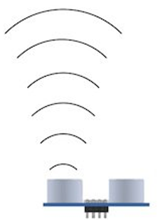

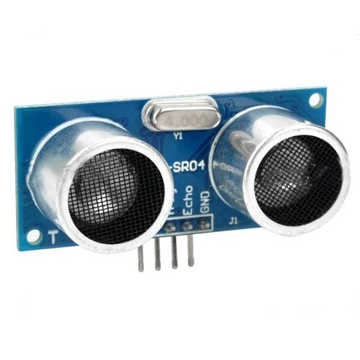
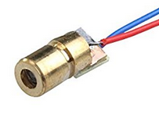
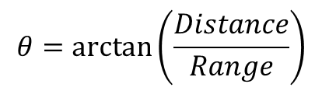
Practical Math
Distance (measured)
Ultra-sonic Distance Sensor
Range (known)
θ
$$θ=\arctan\left(\frac{Distance}{Range}\right)$$
Servo-Mounted Laser Diode

Slide 4
Ultrasonic Distance Sensor
target
Receive
Transmit
The beam is narrow!
About 30°
The target can’t be tilted!
HC-SR04
Little reflection
Soft targets – not so good

Slide 5
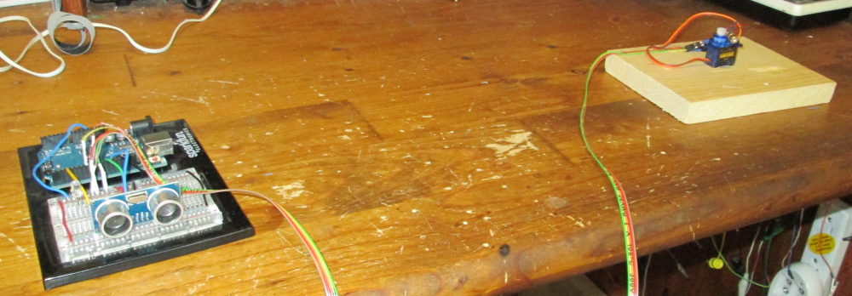
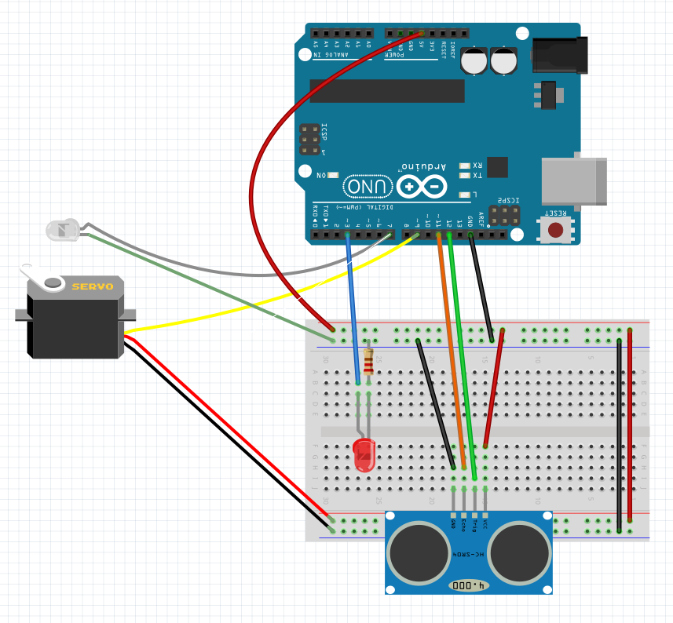
Circuit
Range
Angle θ
Laser Beam
3
7
9
11
12
Distance
OBJECT

Slide 6
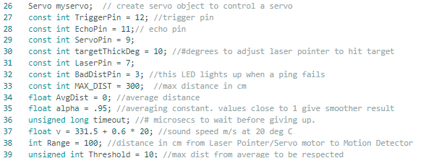
Code

Slide 7
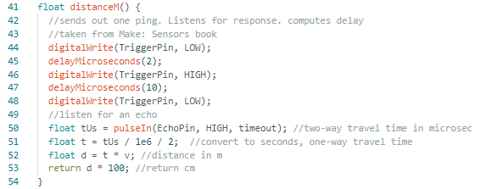
Distance Function

Slide 8
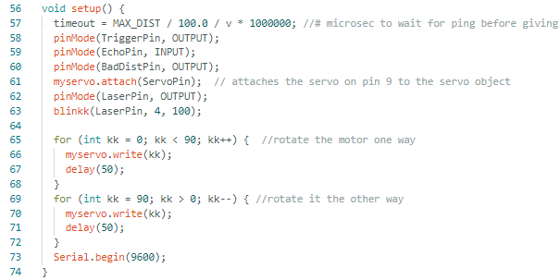
Setup Code

Slide 9
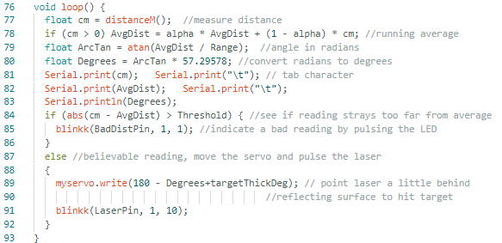
Main Loop

Slide 10
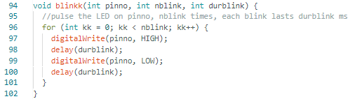
Blink Function

